Slide 1
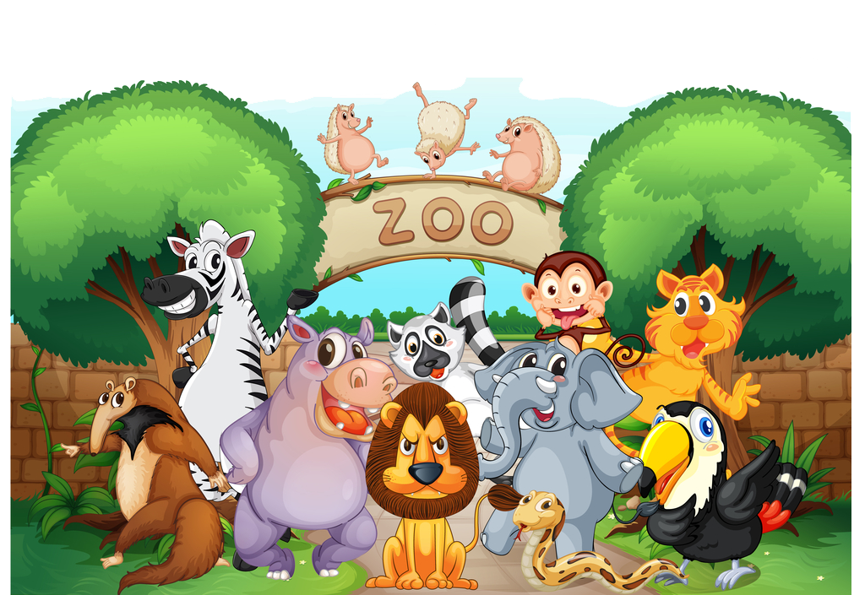

NEURAL NETWORK ZOO
TEAM: FUTURE WIZARDS OF AI

Slide 2
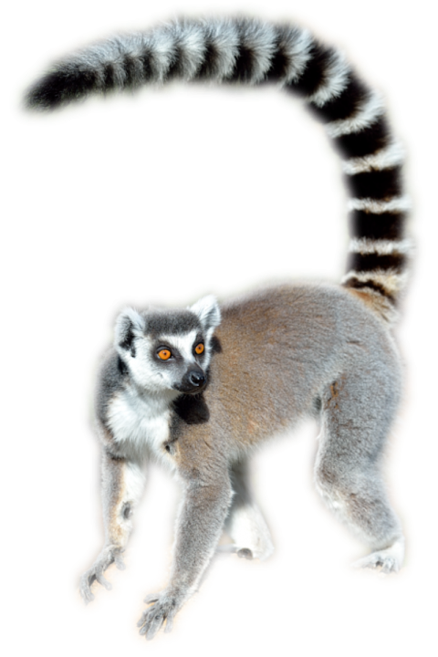
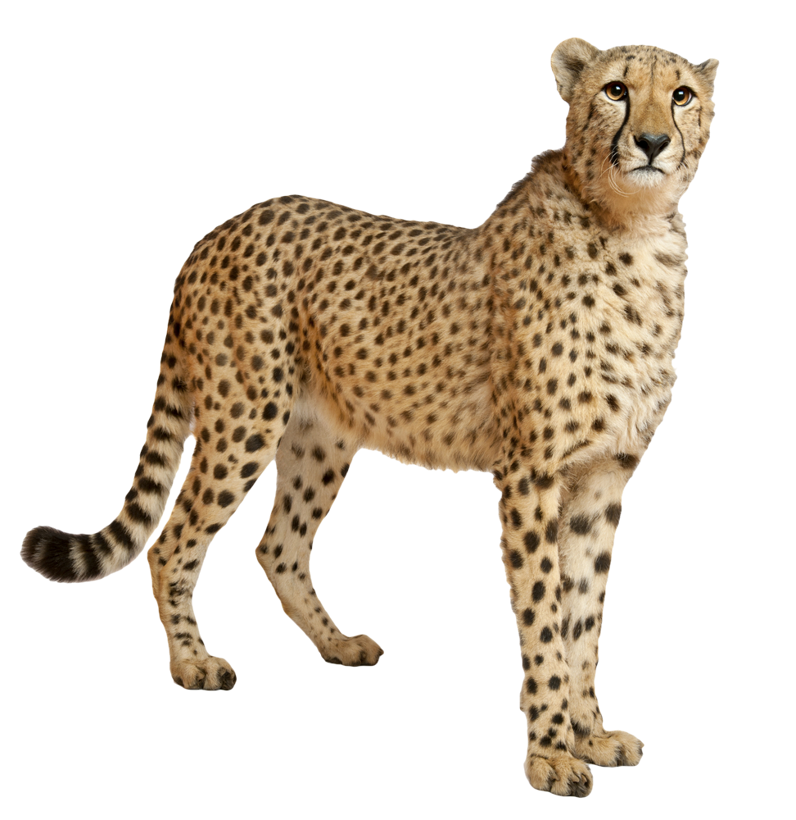
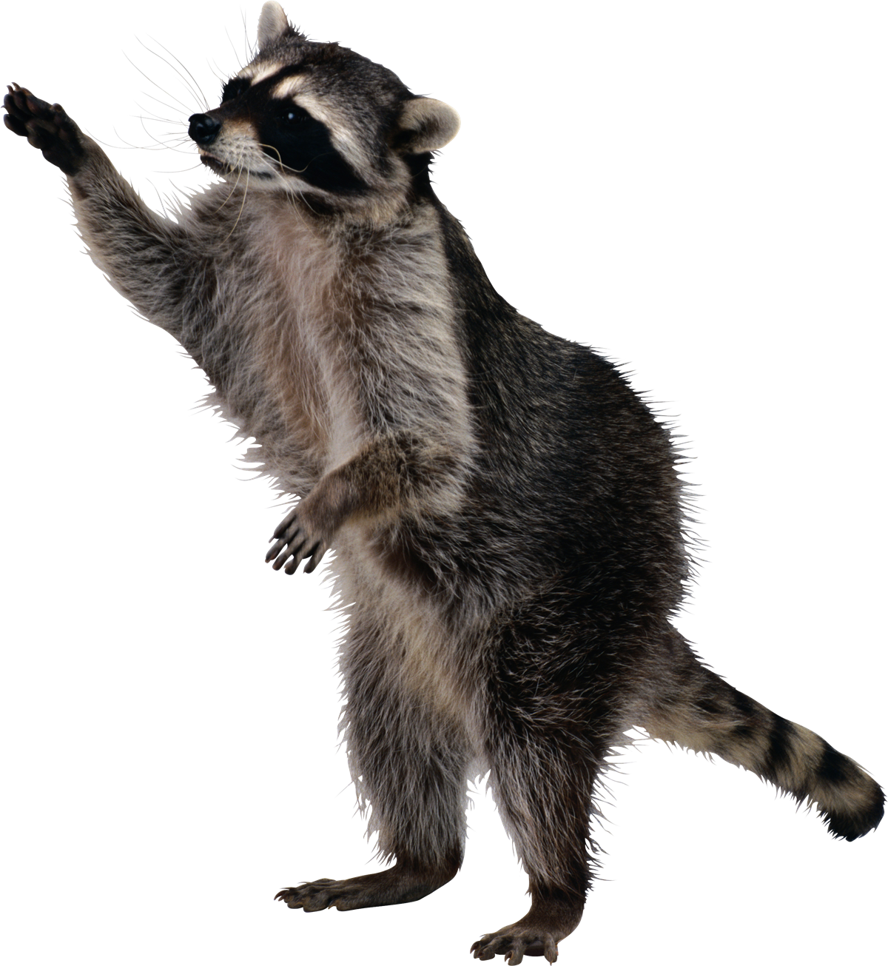
WELCOME TO THE NEURAL NETWORK ZOO
This creative approach includes animals like the Convolutional Neural Network (CNN) Cheetah, Recurrent Neural Network (RNN) Raccoon, and Long Short-Term Memory (LSTM) Lemur, each representing a different neural model based on its traits and functionalities.
MEET CONNIE:
THE CONVOLUTIONAL NEURAL NETWORK CHEETAH
MEET RACHEL:
THE RECURRENT NEURAL NETWORK RACCOON
MEET LESTER:
THE LONG SHORT-TERM MEMORY LEMUR

Slide 3
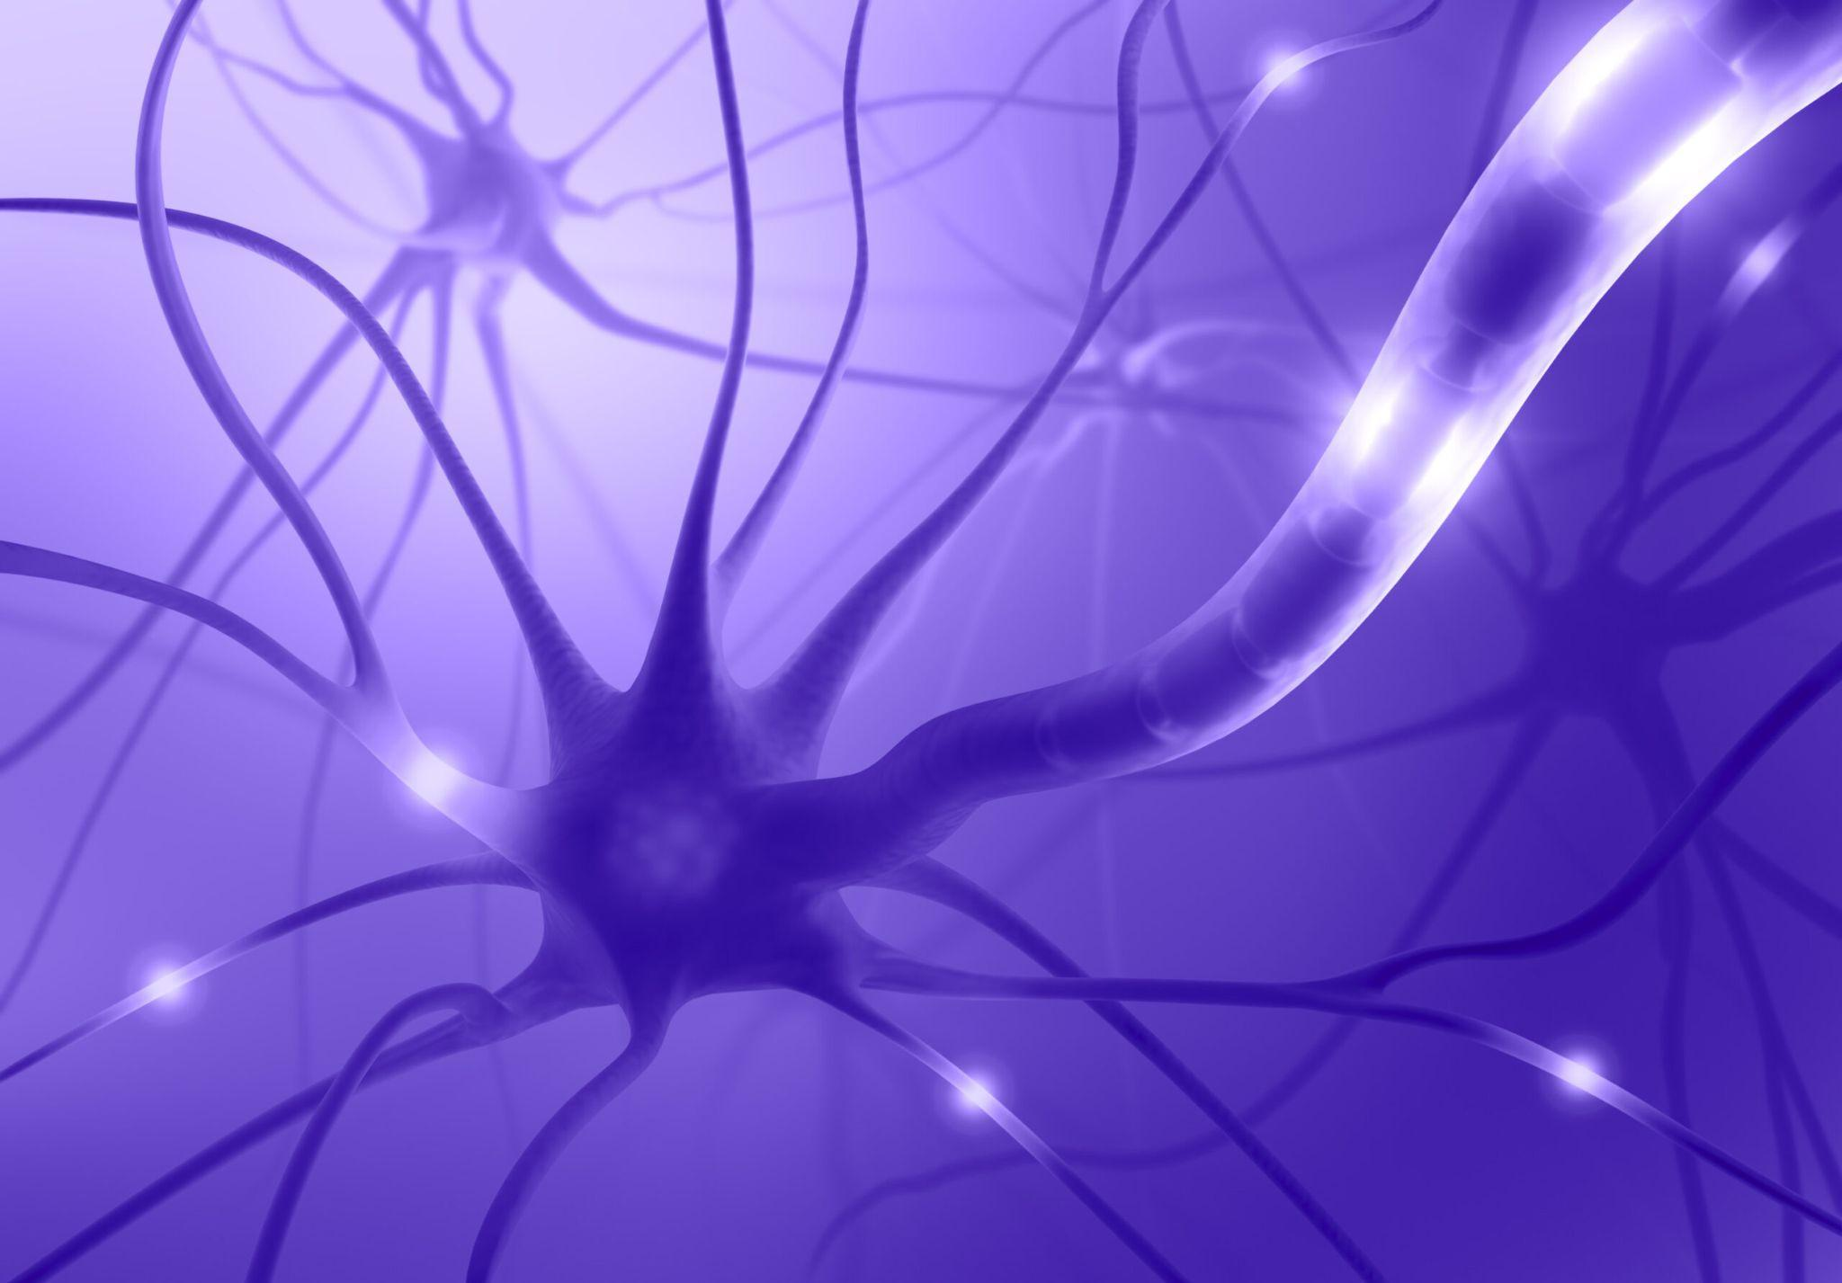
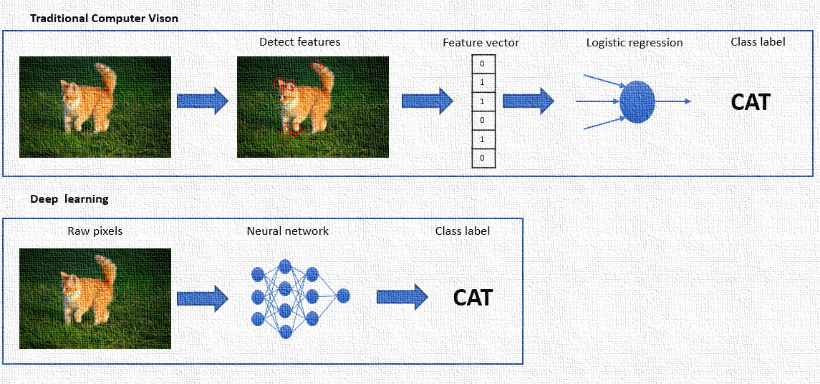
Introduction to Neural Networks
Understanding the Basics
Neural networks are computational models inspired by the human brain's structure. They are fundamental in advancing deep learning, enabling machines to recognize patterns, make decisions, and learn from data without being explicitly programmed.
Basic Structure of a Neuron: A neuron, or node, is the basic unit of a neural network. It receives inputs, processes them based on its weights and biases, and then produces an output. Neurons are organized in layers: input, hidden, and output layers, facilitating complex data processing.

Slide 4
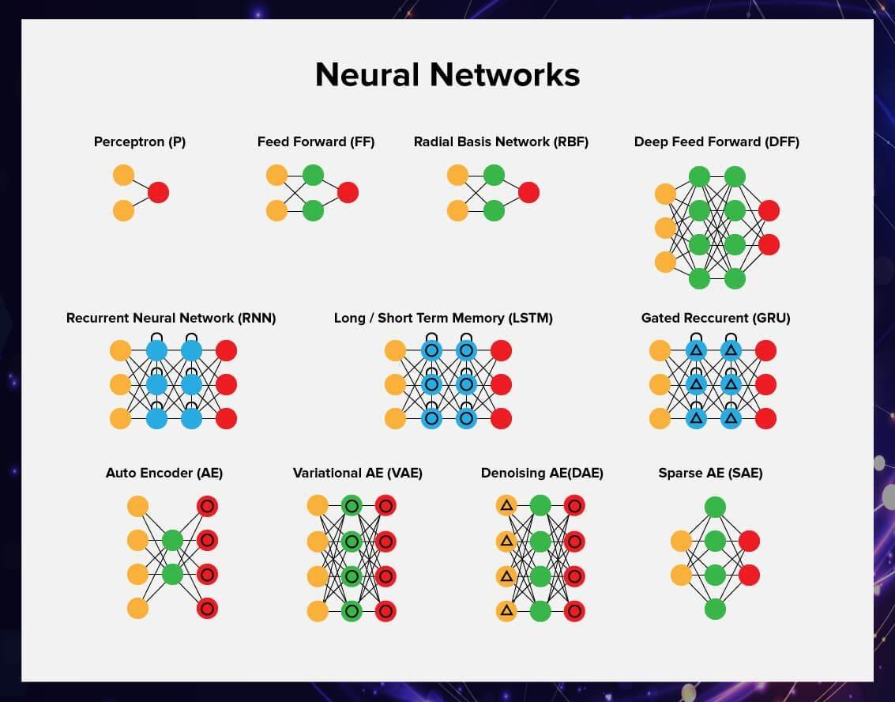

Layers of neurons work together to form a neural network. The input layer receives the data, hidden layers process the information, and the output layer produces the final result. "Neurons" are assembled and linked, enabling them to communicate with one another. The network is then asked to solve a problem, which it repeatedly tries to accomplish, each time enhancing the connections that result in success and weakening those that result in failure.

Slide 5
Hi, I’m Connie,
The Convolutional Neural Network (CNN) Cheetah
FUN FACTS ABOUT ME:
I’m a specialized deep learning model designed for processing data with a matrix-like structure, and excel in tasks like image recognition, object detection, and image classification.
I apply filters to the input to create feature maps, highlighting important visual features like edges, textures, or specific objects.
Pooling layers reduce the dimensionality of the feature maps, allowing me to be efficient in processing and analyzing images.

Slide 6
Hi, I’m LESTER
The Long Short-Term Memory Lemur
FUN FACTS ABOUT ME:
I excel in tasks where context or the sequence of data points is crucial, such as in language translation, speech recognition, and time series forecasting.
I use gates (input, forget, and output gates), which allow me to selectively remember or forget information. This mechanism helps me maintain information over long sequences, highly effective for applications involving long texts or time series data
I have been pivotal in advancing the performance of models in a variety of domains requiring an understanding of sequence and context, such as natural language processing and complex sequence prediction

Slide 7
Hi, I’m Rachel
The Recurrent Neural Network (RNN) Raccoon
FUN FACTS ABOUT ME:
I’m designed for processing sequential data, (such as time series and natural language), by keeping memory of previous inputs in my internal state.
My architecture features loops, which allows information to persist from one step of the sequence to the next; this enables me to capture time-based patterns and relationships in the data.
I have problems with vanishing and exploding gradients, which makes training difficult for long sequences. LSTMs and GRUs have helped.

Slide 8
Let’s play a game!
Daniel Smilkov and Shan Carter created a fun interactive game to help lovers of deep learning such as ourselves to get a better understanding of the concept of Neural networks.
Objective: To understand the basics of neural network architecture and how different parameters affect learning
VISIT playground.tensorflow.org

Slide 9
Conclusion
Review of Approaches
Introducing a dynamic ensemble of neural network models: CNN Cheetah, RNN Raccoon, and LSTM Lemur. Each tailored for specific tasks: CNNs excel in image analysis, RNNs in sequential data processing, and LSTMs in retaining long-term information. By leveraging their unique strengths, we drive innovation across domains, from computer vision to natural language understanding, unlocking transformative AI solutions.
As we continue to refine and integrate these models, we embark on a journey towards a future where AI transforms our world in profound and meaningful ways.

Slide 10

Questions?

Slide 11

Thank you for watching!
TEAM MEMBERS:
Gabrielle Marshall
Bryanna Wallace
Daniel Wright
Patrick Pacheco
Winston Le

Slide 12
References
Smilkov , D., & Carter, S. (n.d.). Tensorflow - Neural Network Playground. A Neural Network Playground. https://playground.tensorflow.org/#activation=tanh&batchSize=10&dataset=xor&regDataset=reg-plane&learningRate=0.03&regularizationRate=0&noise=0&networkShape=4,2&seed=0.81960&showTestData=false&discretize=false&percTrainData=50&x=true&y=true&xTimesY=false&xSquared=false&ySquared=false&cosX=false&sinX=false&cosY=false&sinY=false&collectStats=false&problem=classification&initZero=false&hideText=false
Asquith, N. (2019, December 26). Understanding RNNS, lstms and grus. Medium. https://towardsdatascience.com/understanding-rnns-lstms-and-grus-ed62eb584d90
Shafkat, I. (2018, June 7). Intuitively understanding convolutions for deep learning. Medium. https://towardsdatascience.com/intuitively-understanding-convolutions-for-deep-learning-1f6f42faee1

